Slide 1

Greener Earth A Website On Climate Change
INFORMATION SYSTEM DESIGN AND SOFTWARE ENGINEERING LAB
Data flow and use case diagram
Samin Shahriar Tokey – 14.02.04.066
Naimul Haque – 14.02.04.080
Biozid Niloy – 14.02.04.070
Sanaul Miraj - 14.01.04.131
6th July 2017

Slide 2
Data Flow Diagram
Graphical representation of the flow of data through an information System
Shows what kind of information will be input to and output from the system
Illustrates where data comes from, where it goes and how it gets stored in an information System
2

Slide 3
Types of Data Flow Diagram
Context Diagram
Level1 Diagram
Level2 Diagram
3

Slide 4
Context Diagram
High level view of System
Represents all external entities that may interact with a system
Shows the relationship that the system has with other external entities
4

Slide 5
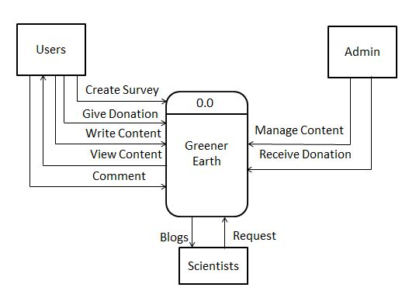
Context Diagram
5

Slide 6
Level 1 Diagram
Provides a more detailed breakout of pieces of the Context Level Diagram
Highlights the main functions carried out by the system
6

Slide 7
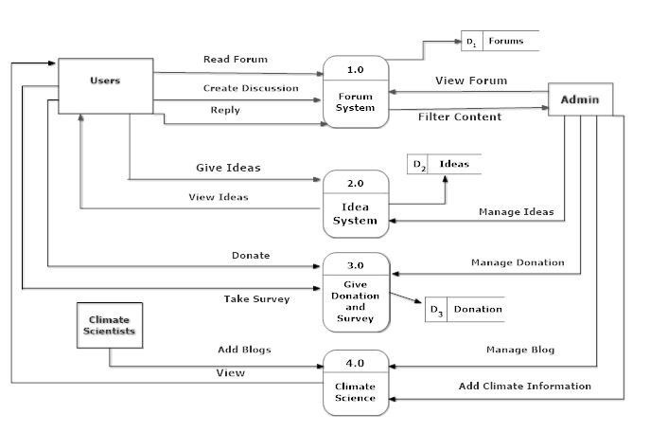
Level 1 Diagram of Greener Earth:
6th July 2017

Slide 8
Level2 Diagram:
Details about the system functioning

Slide 9
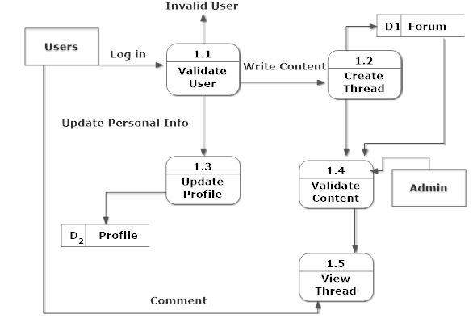
Level 2 Diagram of Greener Earth:
10

Slide 10
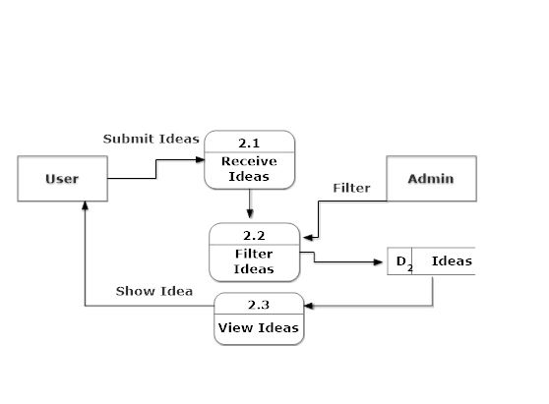
Level 2 Diagram of Greener Earth:

Slide 11
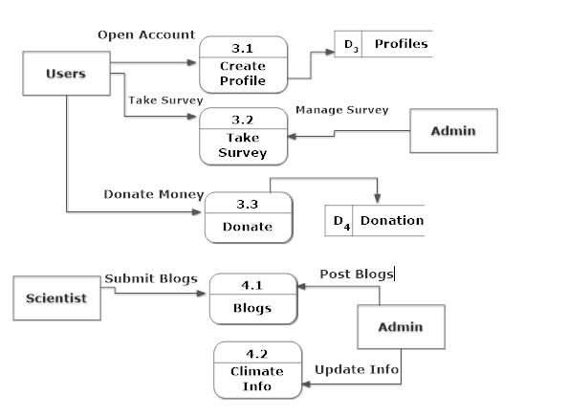
Level2 Diagram Greener Earth:
11

Slide 12
Actors
Users
Admins
Scientists
12

Slide 13
Use Case Diagram
Post Ideas
Create Account
Verify Account
<<include>>
Take Survey
<<include>>
User
Donate
<<include>>
Login
Filter Content
Create Forums
<<include>>
<<include>>
Update Blogs Given by Scientists
Manage Content
Scientists
User

Slide 14

Thank you

